Slide 1
TB based on SystemVerilog Introduction
Jinfeng.Huang
2017/11/21

Slide 2

SV testbench
Components
Objects
Randomize
Compile and Run
Q & A

Slide 3
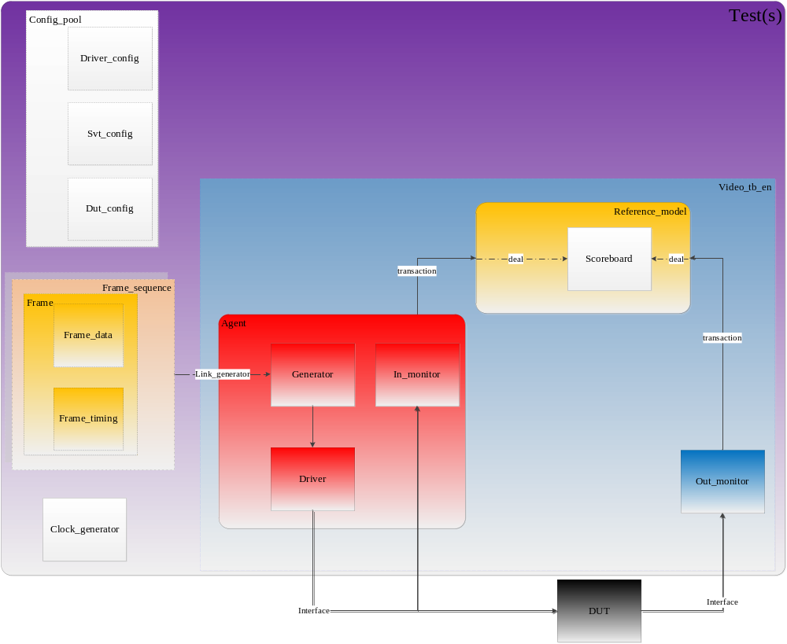
SV testbench

Slide 4
Components

Slide 5
Components
Frame_Agent: container of driver, generator and in_monitor
Frame_Driver: request transaction from generator, trans it to pin level signal
Frame_Generator: get transactions, and deliver it to driver
Frame_Monitor: source monitor, detect the input signals, and send the pixel data(in transaction level) to reference model
Out_Monitor: output monitor, detect the DUT output signals, and send the pixel data(in transaction level) to reference model
Frame_Refm: gen golden pixel as needed, and submit transaction to scoreboard
Frame_Scoreboard: compare the frame pixel data)

Slide 6
Objects

Slide 7
Objects
Config_pool: container of driver_config , svt_config and dut_config
Driver_config: source video timing config, clock config, etc.
SVT_config: source video timing only
dut_config: dut variable config, dut register setting
Clock_generator: produce the clocks according to the setting of Driver_config. Take it as PLL.
Frame : container of frame_data and frame_timing, an information for one frame
Frame_data: pixel value of frame
Frame_timing: timing information for frame. Including resolution, front porch, back porch, etc.

Slide 8
Randomize

Slide 9
Randomize
resoultion type: from file, from command, from constraint randomize
pixel value: from file, absolutely randomize
format and color depth
link lane num and link clock
Contiuning...

Slide 10
Compile and Run

Slide 11
Compile and Run
>> irun_uvm.pl -sel -c/-s/-r (-cov)
run flow
coverage opiton (-cov)
regression option (-b batch=***.file)

Slide 12

Waiting for ...
Topic on TB based on SystemVerilog
Topic on SVA and Function coverage
Topic on UVM
Topic on TB based on UVM

Slide 13
Q&A
Thank you

